Slide 1
සිදත්
Sinhala Grammar Checker

Slide 2
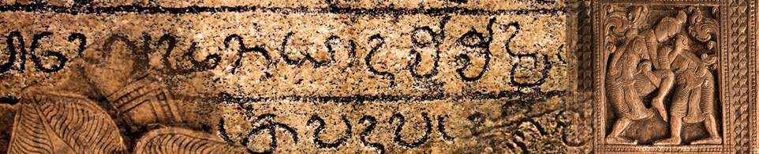
Overview
Sinhala is the most spoken language in Sri Lanka. It is one of the official languages.
There are less support applications for Sinhala documentation specially for grammar checking.
සිදත් (Sidath) Sinhala grammar checker has been developed as a document processing application plug-in to help the user with Sinhala grammar

Slide 3
Problems to solve
The need of Grammar checking tool for documents written in Sinhala
Difficult to find suitable tools which support the Sinhala language.
Sinhala being a low resource language.
Good translation tools need grammar checking.

Slide 4
Project objective
Developing a Grammar Checking tool for Sinhala Documents

Slide 5
Deliverables
Stand-alone web application to check Sinhala grammar.
Sinhala verb morphology analyzer API.
1
3
Sinhala Grammar Checker API for developers who are interested in developing more sophisticated tools for Sinhala like Sinhala translation tool.
2

Slide 6

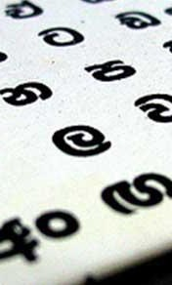
Research on Sinhala Language
A thorough study of Sinhala Language and grammar
Categories of Sinhala words
නාම පද
ක්‍රියා පද
විශේෂණ පද
නිපාත
Reference: Karunathilaka, W. (2015). Sinhala Bhasha Wiyakaranaya.

Slide 7
Number
Single
Plural
Tenses
Past
Non Past
Gender
Masculine
Feminine
Neuter
Person
First Person
Second Person
Third Person

Slide 8
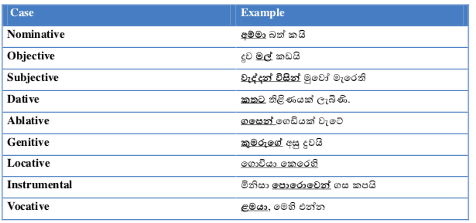
Cases in Sinhala

Slide 9


Morphology
Sinhala is a highly morphological language
Noun morphemes and verb morphemes
Different categories of words according to morphology
QUICK TIP
Try right clicking on a photo and using "Replace Image" to show your own photo.

Slide 10
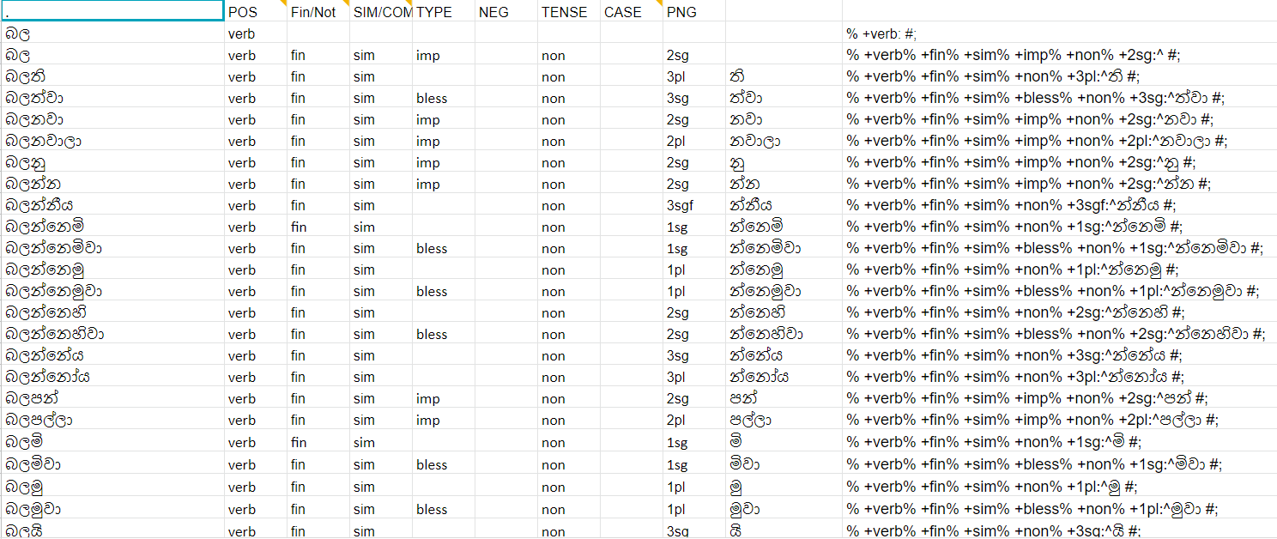

Slide 11
Verbs categories
අ ගණය
අදි ගණය
අරි ගණය
වඳී ගණය
උපදි ගණය
නවති ගණය
එ ගණය
ගන් ගණය
ක ගණය
ව ගණය
ය ගණය
දෙ ගණය
බො ගණය
කර ගණය
ලබ ගණය
වෙ ගණය
ඉන් ගණය
නිවැරදි සිංහලය - Professor J.B. Disanayake

Slide 12
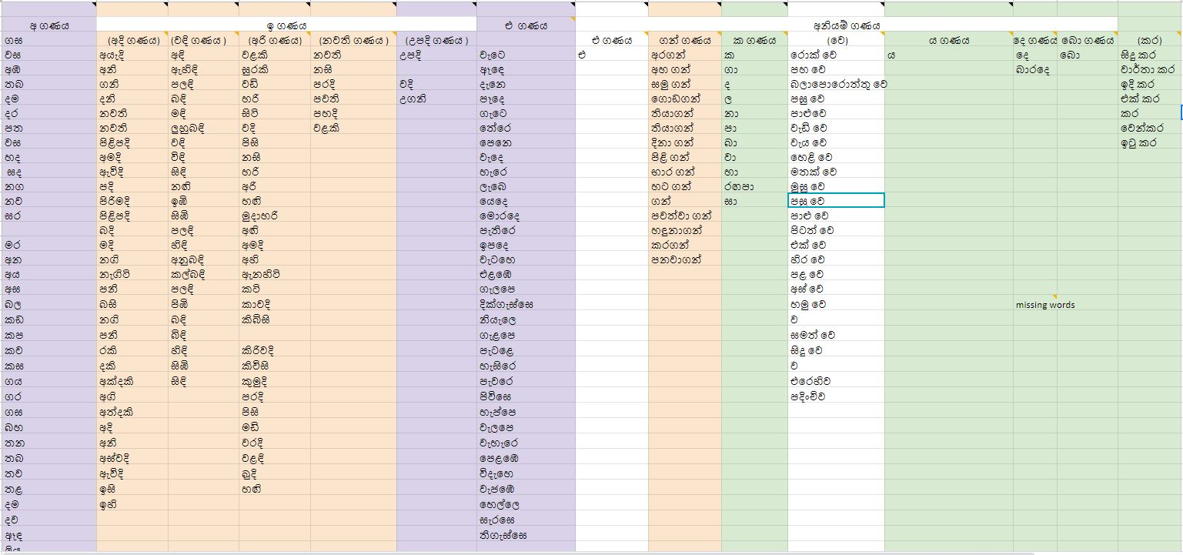

Slide 13
FOMA
Foma is a compiler, programming language, and C library for constructing finite-state automata and transducers for various uses.
FOMA is used to compile Regular expressions written to a transducer to get the result
This can be used to analyze morphology using the finite state transducer

Slide 14
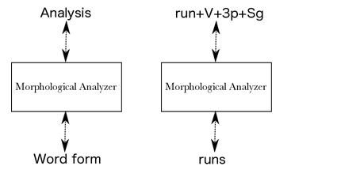
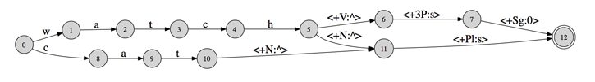

Slide 15
Grammar Checking
Deep Learning
Data analytics/Deep learning uses data on the language to process.
This need annotated data for processing.
This is learning from past experience to learn the current situation.
This needs a significant amount of data and computer power to create these models.

Slide 16
Project: DeepCorrection 3: Spell correction and simple grammar correction
Author: Praneeth Bedapudi
Trained on 8000000 sentences
PROJECT: GRAMMATICAL ERROR CORRECTION SYSTEM WITH DEEP LEARNING AUTHOR: Jose Silva California State Polytechnic University
Trained on nearly 392000 sentences

Slide 17
Spell and Grammar Checking Tool for Sinhalese අකුරු ස ෝදුව - සියබ සුබ ක් කරනු රිසිසයන
Sri Lanka Institute of Information Technology, Malabe, Sri Lanka. Department of Sinhala, Faculty of Arts2 , University of Colombo
Grammar checking using machine leaning
Input correct sentences = 25, System identify only 2 sentences.
Input incorrect sentences = 30, System identify only 4 sentences.

Slide 18
XLE
XLE is a computational environment that assists in writing and debugging Lexical Functional Grammars (LFGs) .
It provides linguists with a facility for writing syntactic rules and lexical entries, and for testing and editing them.
It also provides an interface with finite-state morphological analyzers. The system applies these specifications to sentences or other strings and then provides the following analytic information:

Slide 19
Implementation

Slide 20



Methodology
Building Sinhala Grammar using Lexical Functional Grammar
Morphological Analyzer
Final product
01
03
02
Notes:
Rule based approach to test the grammar.
we need to know the meaning of each word in the sentence
In sinhala there are many agreements, cases, which depends on the morphemes of words
so need to extract details out of the words specially verbs.

Slide 21
Morphology
නට + ව + න්නීය
Notes:
ව - force someone to do the act
න්නීය - 3rd person, singular, feminine verb, final verb and present tense

Slide 22
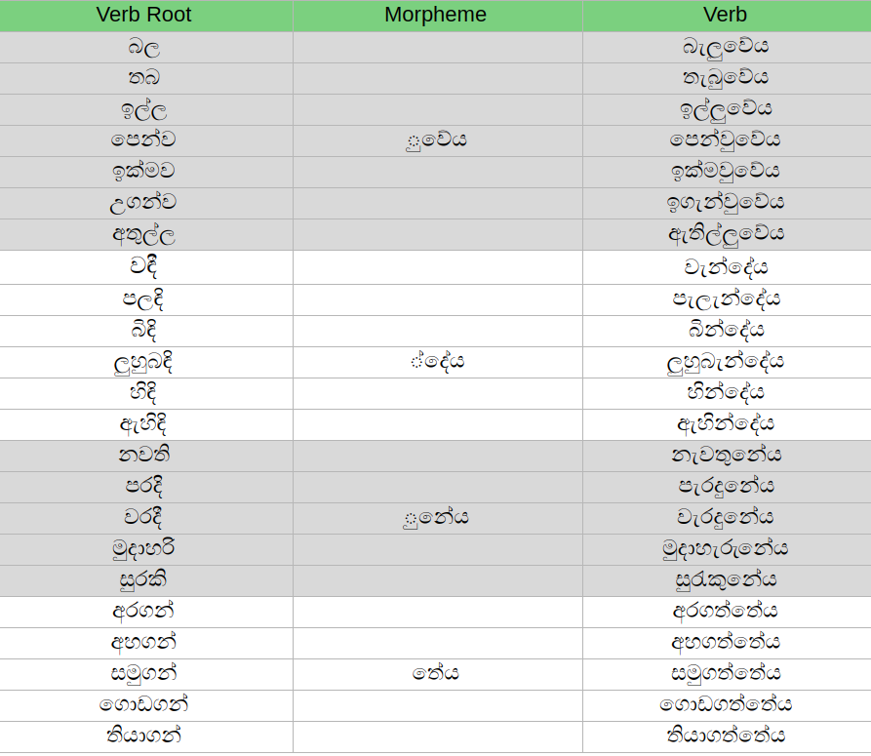
3rd person,
Singular,
Masculine,
Past Tense verb form
Notes:
more than 200 derivatives from each verb root and we identified around 80 commonly used verb derivatives from each root.

Slide 23
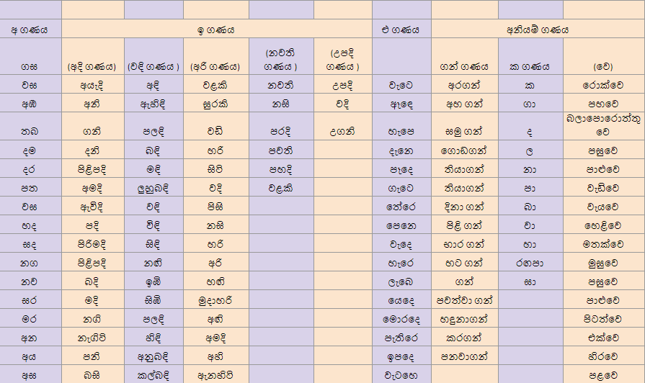
Notes:
trained morfessor (unsupervised ML model for morphological segmentation) with sinhala and segmentate sinhala verbs,
using a python script, divided those roots in to main classes.

Slide 24
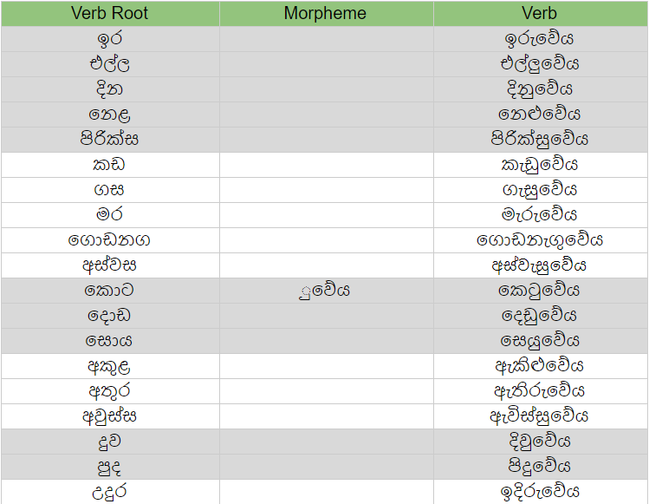
Notes:
3rd person, Singular, Masculine, Past Tense verb form

Slide 25
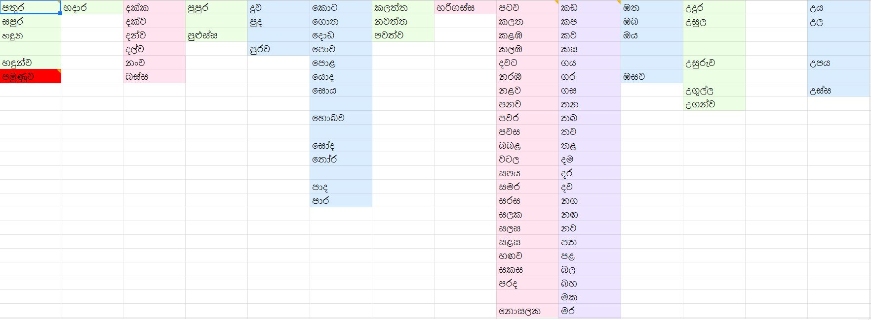
Sub Classes for the First Verb Class (අ-ගණය)
Notes:
33 sub classes.

Slide 26
Morphological Analyzer for Verbs
FOMA as the technology
Identifying the root verb and its derivatives
Integrated with a web interface.
QUICK TIP
Try right clicking on a photo and using "Replace Image" to show your own photo.
Hulden M. “Foma: a finite-state compiler and library” in EACL '09 Proceedings of the 12th Conference of the European Chapter of the Association for Computational Linguistics, Athens Greece, 2009.
Notes:
In FOMA we are providing the verb roots and the set of morphemes related to each group of verb roots in a lexicon data file. For each lexicon file, we should apply a unique set of regular expressions (re-write rules) to generate the verb forms correctly

Slide 27
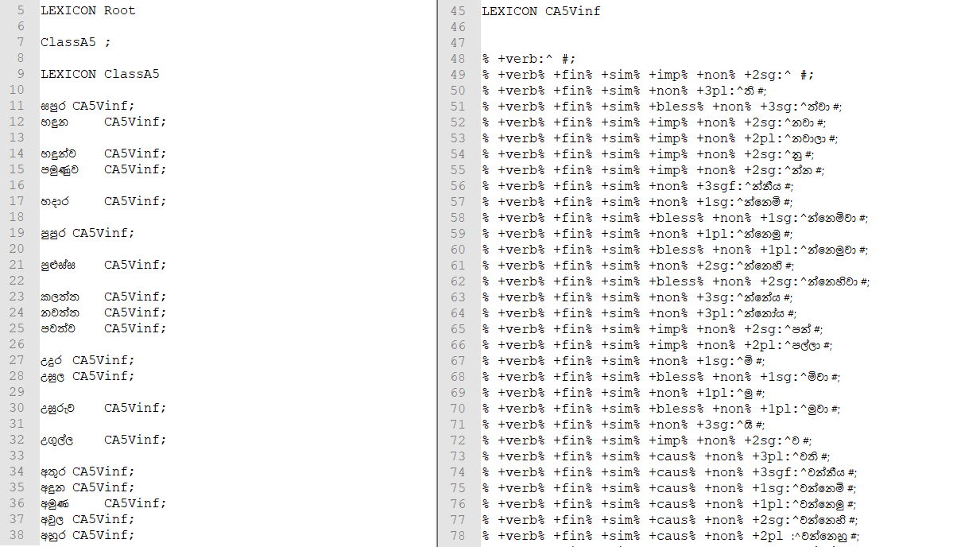
Notes:
lexicon file for one of 33 sub classes.

Slide 28
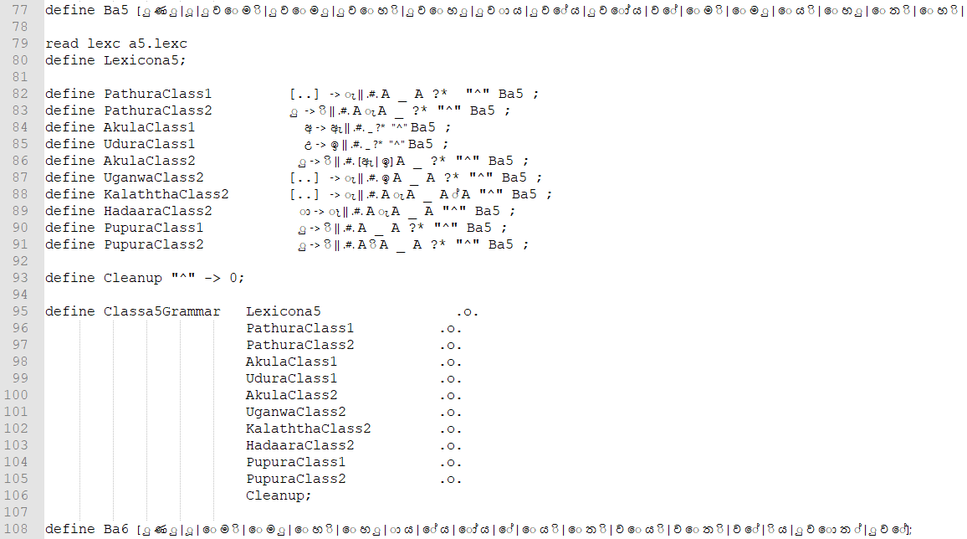
Notes:
set of regular expressions apply on the above lexicon file to generate correct verb form.

Slide 29
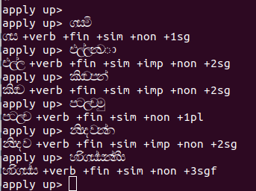
Notes:
tag set?

Slide 30


Slide 31
Our current verb collection has 360 verb roots and each verb root has around 70 derived verbs. All together our verb morphological analyzer can currently handle more than 24000 different verbs.

Slide 32
Lexical Functional Grammar
Both Deep and Shallow parsing are needed.
We selected XLE.
QUICK TIP
Try right clicking on a photo and using "Replace Image" to show your own photo.
Reference: Ling.uni-konstanz.de. (2019). XLE Project. [online] Available at: http://ling.uni-konstanz.de/pages/xle/ [Accessed 8 Feb. 2019].
Notes:
Other considerations: NLTK (does shallow parsing, not suitable for free word order)

Slide 33
We collected the Sinhala school-books from grade 1-5 and used them as a guideline to develop the grammar rules in XLE step by step parsing the sentences in those books from grade 1 to 5.
As the first step of the grammar rule development, we parsed simple 3-word sentences in the general Sinhala word order Subject-Object-Verb.
Notes:
first we try to pragram senteses to create grammar rule

Slide 34
Grammar Scope
Simple sentences with Subject, Object and Verb
Simple sentences with adjectives and adverbs
Simple sentences with secondary object
Sentences with non-finite verb clauses
purva kriya (e.g. නටා)
mishra kriya (e.g. නටමින්, නටද්දී)
QUICK TIP
Try right clicking on a photo and using "Replace Image" to show your own photo.

Slide 35
We developed the grammar to handle more grammar as mentioned below,
Check subject verb agreements (Person, Number and Animacy).
Identifying adjectives, adjective phrases, adverbs and adverb phrases.
Handling case mismatch between verb and primary object.
Handling case mismatch between verb and secondary object.
Identifying complex sentence with clauses containing non-final verbs

Slide 36
Simple sentences
Regular Expression | Example
S.V | මම යමි.
S.(O).V | මම ගෙදර ය​මි
A*. S. A*.O.Ad*. V | ලස්සන ළමයා යයි ලස්ස​න ළමයා ගෙදර යයි. උස ළමයා ලස්සන නටුම් නටයි

Slide 37
Simple Sentences with secondary object
Regular Expression | Example
A*. S. A*.O2.A*.O1.Ad*. V | ළමයා ඔහුට පොතක් දුන්නේය

Slide 38
Complex Sentences
Regular Expression | Example
A*. S.Ad*.NonfV. (A*.O2).(A*.O1).Ad*. V | මම ලස්සනට නටමින් සින්දු කිව්වෙ​මි
A*. S.(Ad*O).Ad*.NonfV. (A*.O2).(A*.O1).Ad*. V | මම ලස්සන නැටුම් නටමින් සින්දු කිව්වෙ​මි
A*. S0.(Ad*O).Ad*.NonfV. S1.(A*.O2).(A*.O1).Ad*. V | ඔහු සින්දු කියද්දී මම නැටුම් නැටුවෙමි.

Slide 39
Arguments for verbs
In Sinhala, verbs require agreement with the subject for :
Number
Person
Animacy

Slide 40
Case Handling
Case handling is done for secondary objects within the scope
Case | Verb Example
Dative | දෙන​වා
Ablative | ගන්න​වා

Slide 41
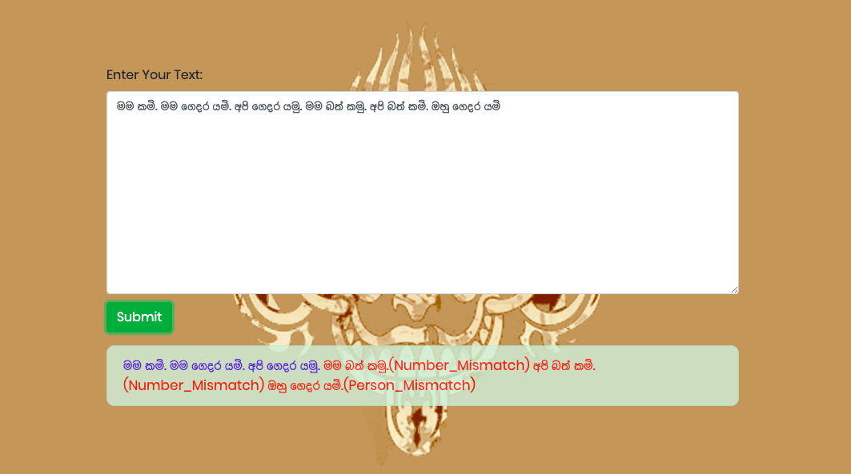

Slide 42
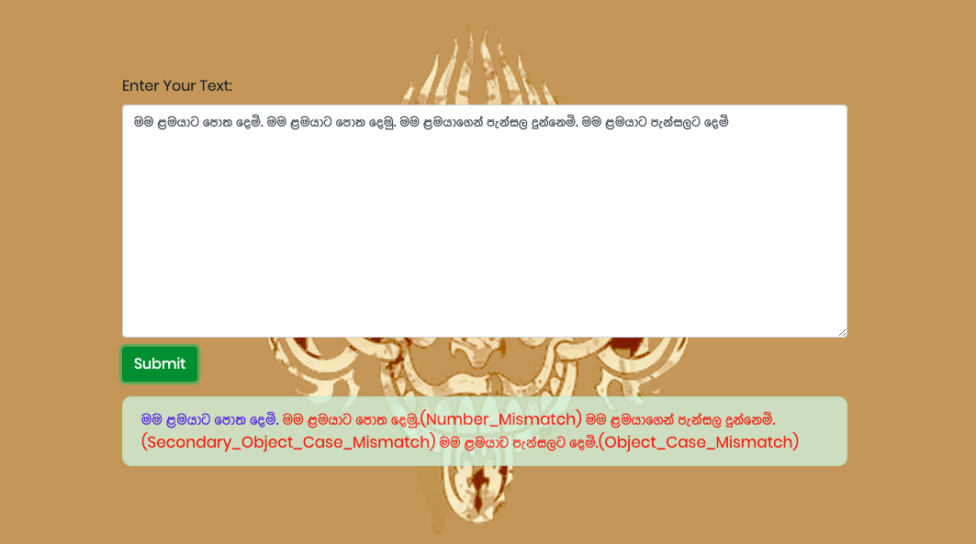

Slide 43
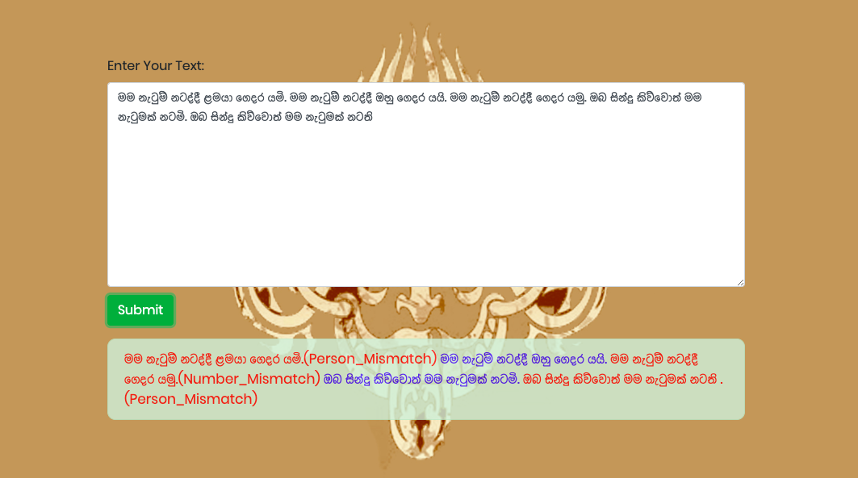

Slide 44
Testing and Validation
Syntax based Coverage
Production coverage
*http://www.cs.gmu.edu/~offutt/softwaretest/
Notes:
For the grammar checker

Slide 45
Production Coverage
Production Coverage (PDC) : Testing Requirement contains each production p in the grammar G.

Slide 46
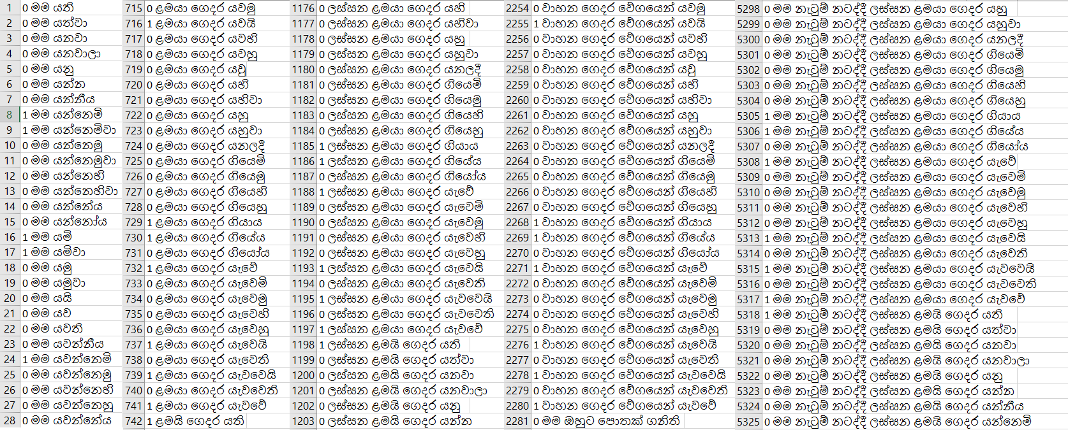
Test dataset of 16920 labeled sentences
Notes:
Labeled using python scripts and manual effort.

Slide 47
Testing Results
 | Positive | Negative
True | 2181 | 13781
False | 352 | 606
Precision 0.8610
Recall 0.7826
Accuracy 0.9434
Notes:
Accuracy of 94% within our scope

Slide 48
Challenges
Sinhala Linguistics
Integrating FSTs with XLE
Rule overriding
Catching Errors

Slide 49
Integrating FST with XLE
FST outputs were not directly integrated to XLE
Python scripts were written to integrate FST output with XLE

Slide 50
Rule Overriding
We used trial and error approach.
Each model was remodeled after trial

Slide 51
Catching errors
Seperate grammar error model was built to identify errors

Slide 52
Conclusion and Future work
We have developed a working grammar checker for Sinhala Language
Computational Grammar can be used to develop grammar checker for Sinhala language
FSTs can be used to analyze Morphology.

Slide 53
Key References
Butt, M. and King, T. (2002). Urdu and the Parallel Grammar Project. In: COLING '02 Proceedings of the 3rd workshop on Asian language resources and international standardization. Association for Computational Linguistics.
Ling.uni-konstanz.de. (2019). XLE Project. [online] Available at: http://ling.uni-konstanz.de/pages/xle/ [Accessed 8 Feb. 2019].
Karunathilaka, W. (2015). Sinhala Bhasha Wiyakaranaya.
Hulden M. “Foma: a finite-state compiler and library” in EACL '09 Proceedings of the 12th Conference of the European Chapter of the Association for Computational Linguistics, Athens Greece, 2009.

Slide 54
B. Hettige and A. Karunananda, "A Morphological Analyzer to Enable English to Sinhala Machine Translation," in 2006 International Conference on Information and Automation, Colombo, 2006.
T.N.E. Fernando and A.R. Weerasinghe, “A Morphological Parser for Sinhala Verbs” University of Colombo, School of Computing

Slide 55
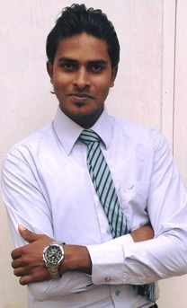
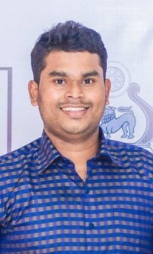

Team Sidath
Piyumal Dhananjaya - 150119U
Prabhash Rathnayake - 150529C
Kalindu Kumarasinghe - 150345H
Piyumal
Prabhash
Kalindu

Slide 56
Thank you.

